Slide 1

Kent Institute Academic Administration Management System (KIAAMS)
Developed by: Yeti Tech
Members:
Samarpan Baniya
Avisekh Khadka
Bibek Shrestha
Ayush Shrestha
Prasanna Sapkota
Developed by: Yeti Tech
Members:
Avishek Khadka (K240081)
Prasanna Sapkota (K231941)
Samarpan Baniya (K240256)
Aayush Shrestha (K240120)
Bibek Shrestha (K240204)

Slide 2
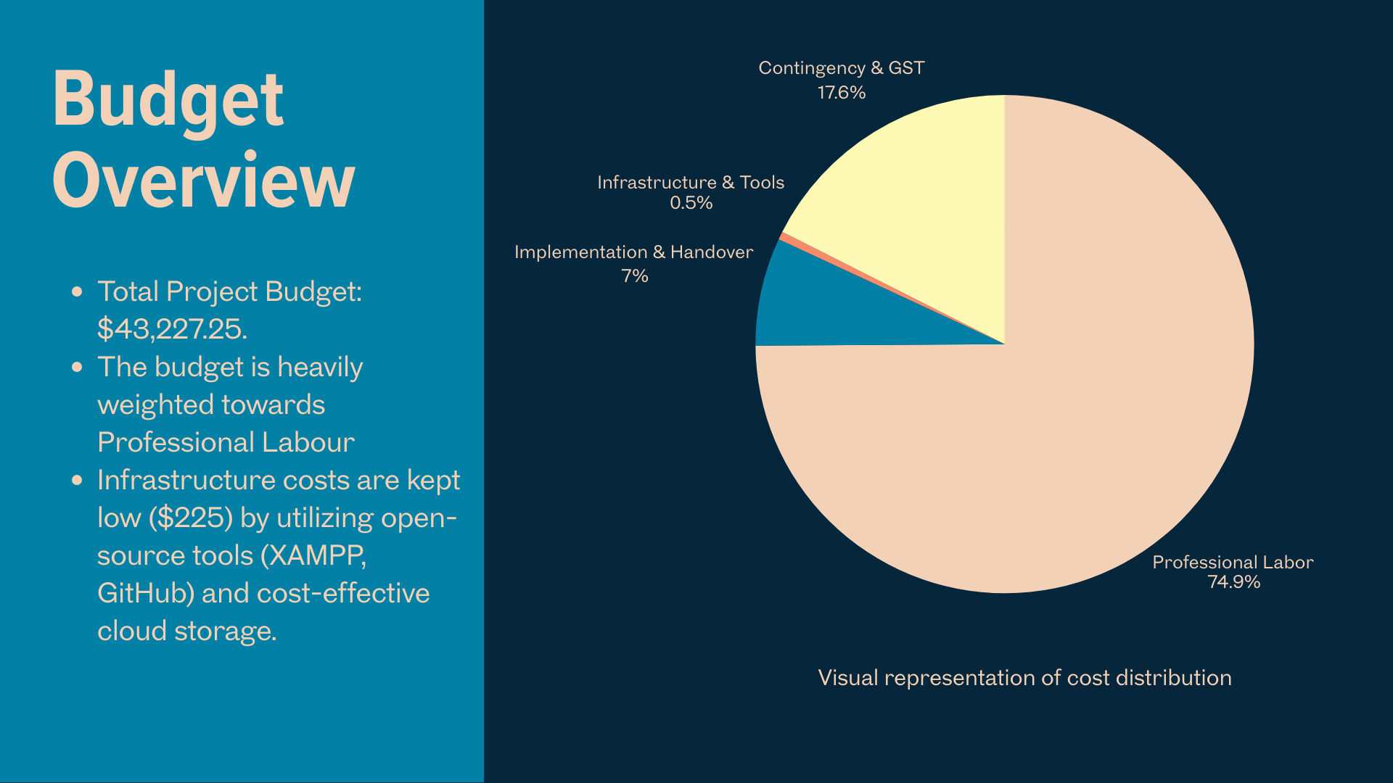

Slide 3
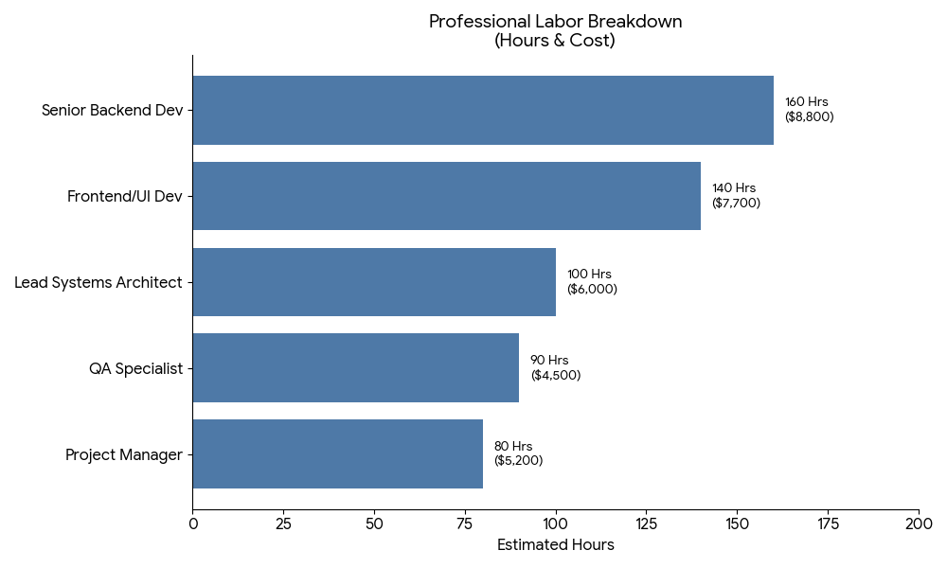

Slide 4
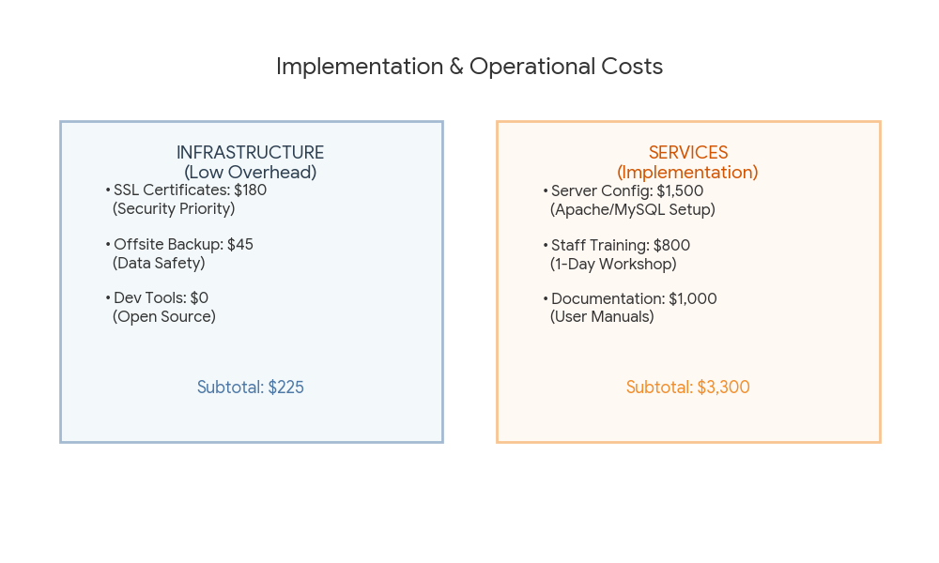

Slide 5
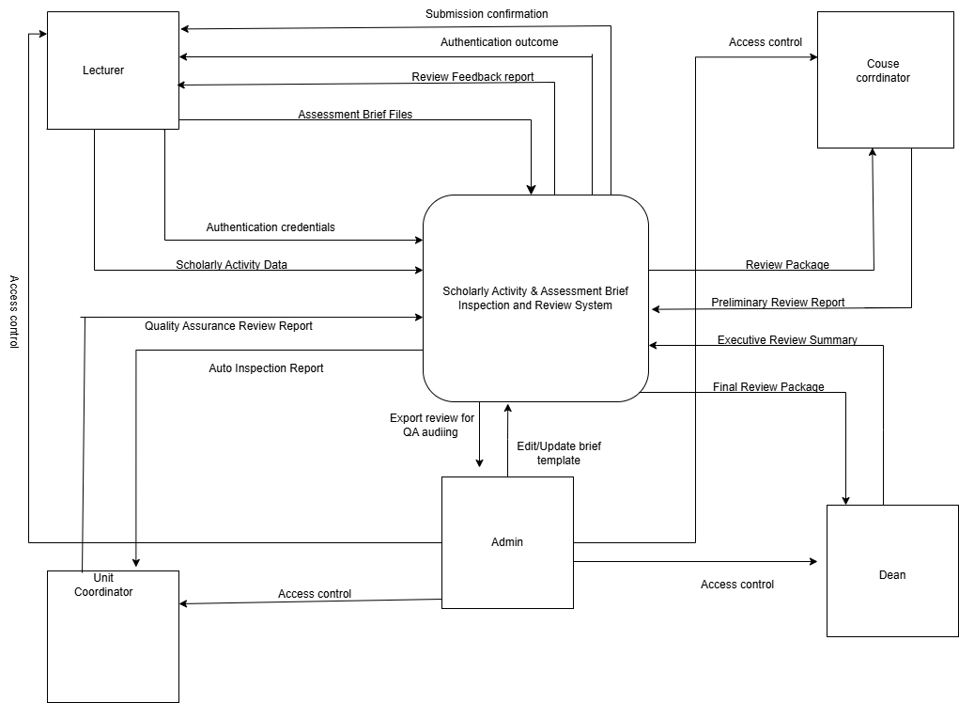
Context Diagram (DFD Level 0)

Slide 6
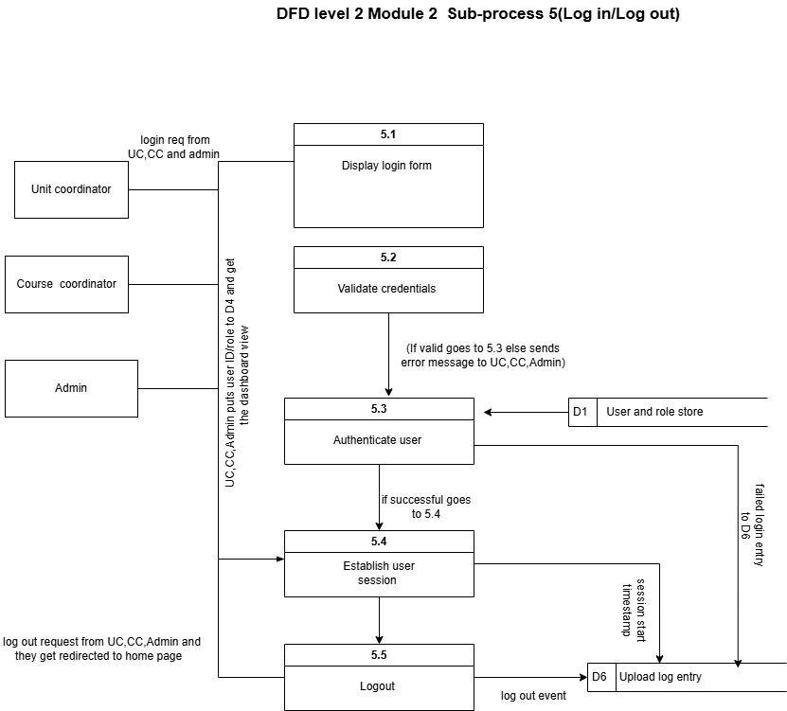
DFD Level 2 (Module 2)
Sub-process 5: Log-in/log out

Slide 7
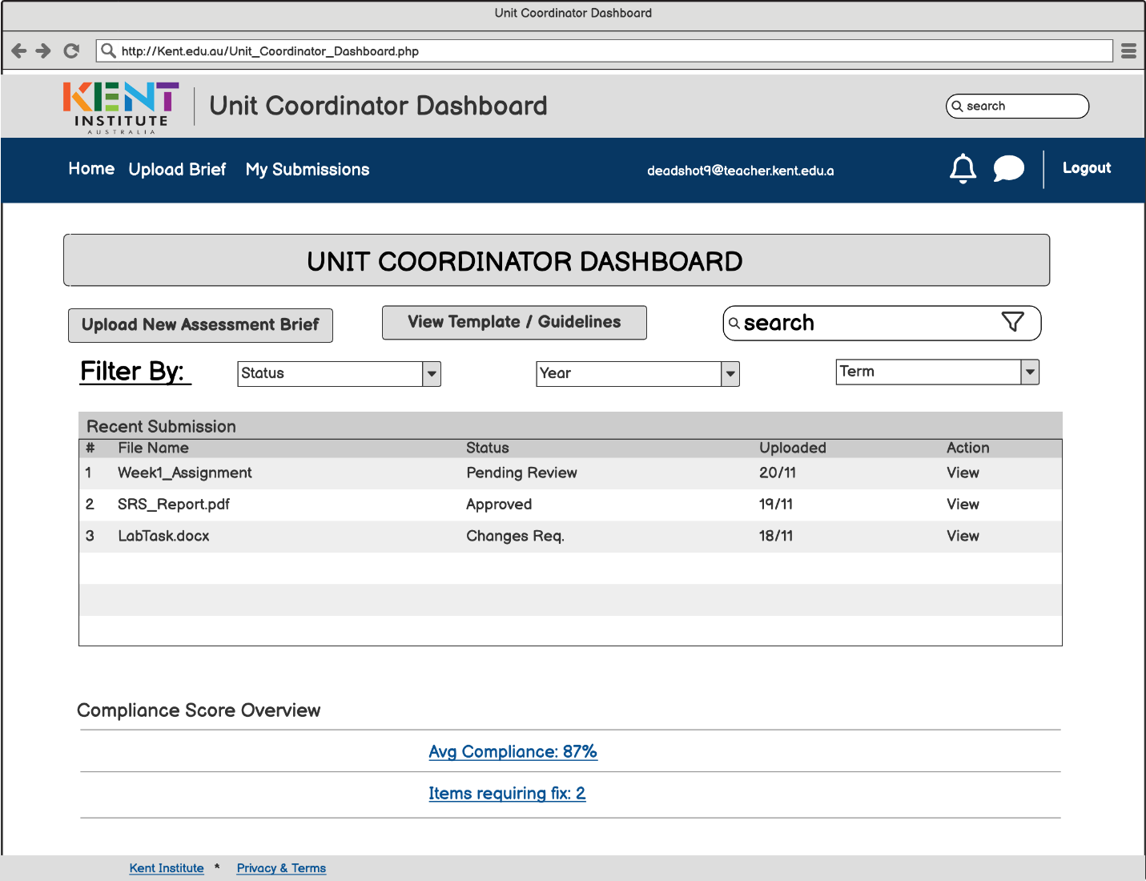
Assessment Administration (AAMS)
Unit Coordinator Dashboard

Slide 8
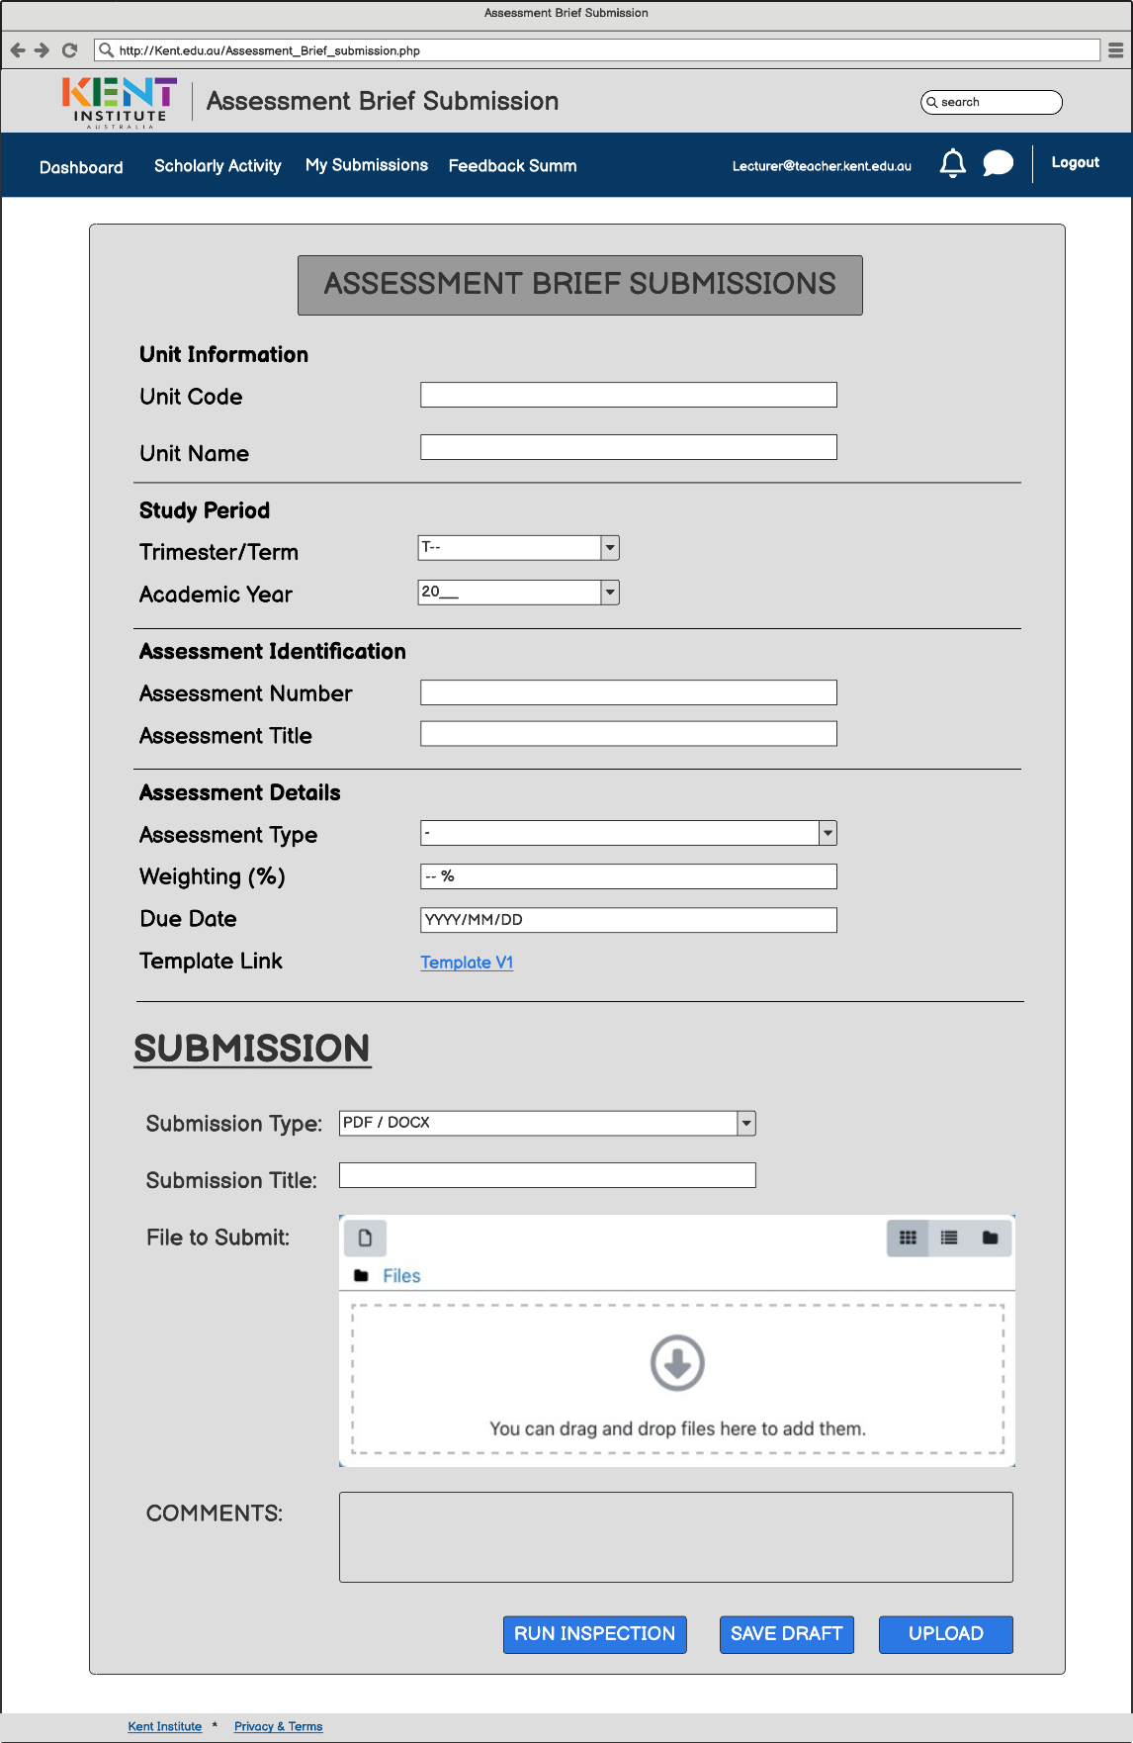
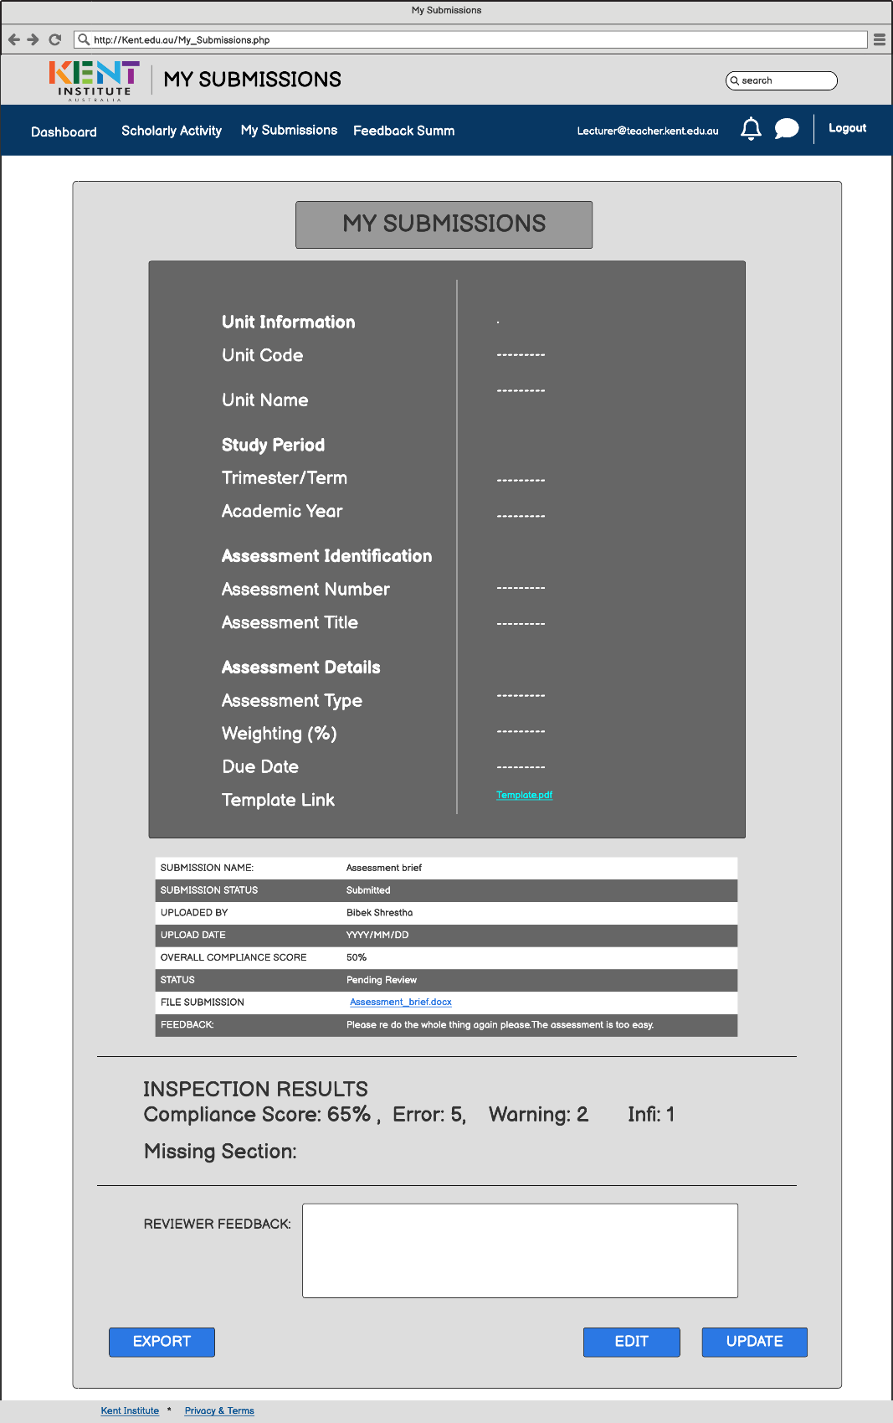
AAMS- Assessment brief submission & My Submission

Slide 9
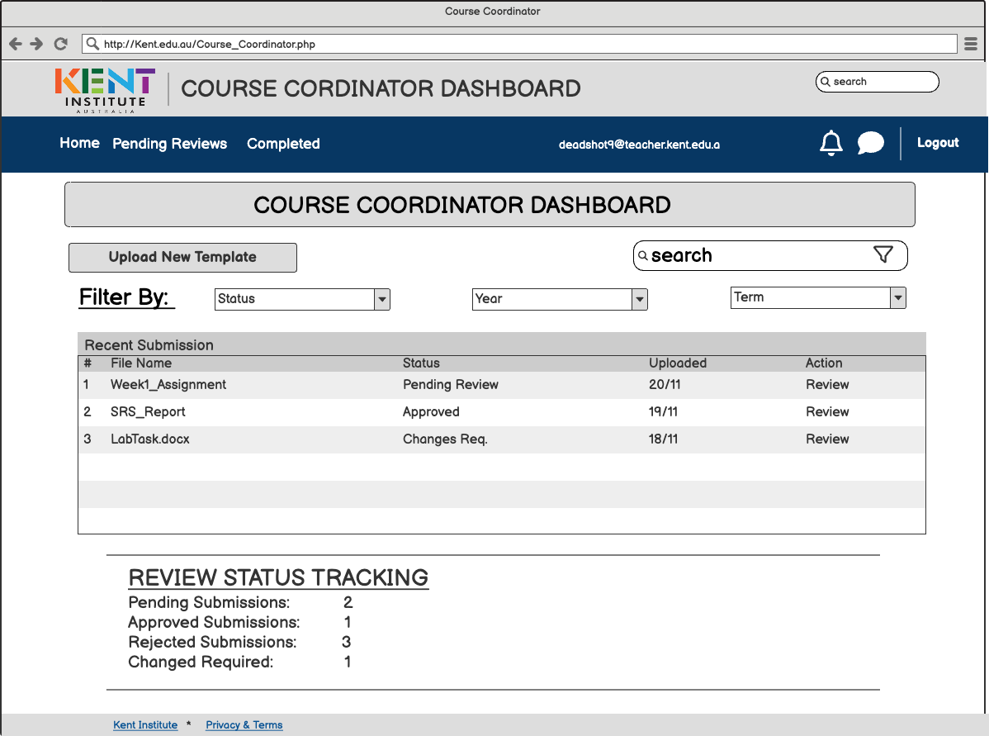
Assessment Administration (AAMS)
Course Coordinator Dashboard

Slide 10
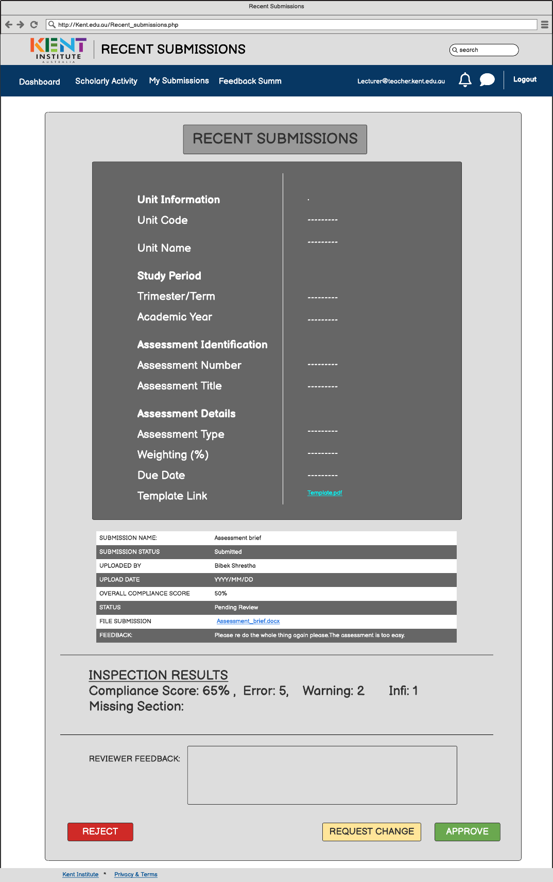
AAMS- Course Coordinator Recent Submission

Slide 11
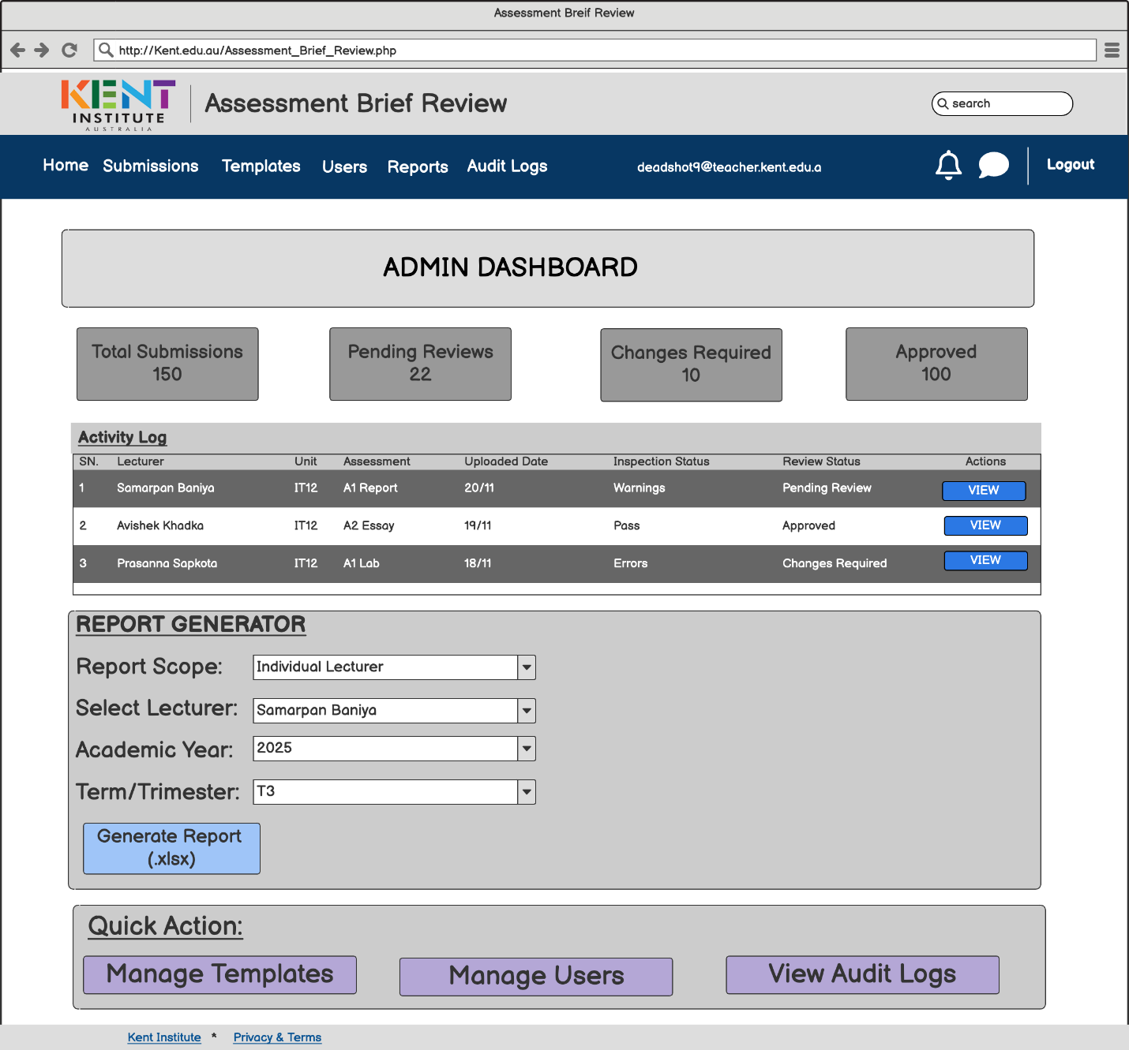
Assessment Administration (AAMS)
Admin Dashboard

